Slide 1

Reserve Center of Excellence (RCOE) Brief
For
CNRFC
Hosted by Transaction Service Center Norfolk

Slide 2
References:
OPS ALERT With Current Case Routing Guidance (CRG)
MyNavyHR: https://www.mynavyhr.navy.mil/
MILPERSMAN 1306-1502: Enlisted Reserve component to Active Component (RC2AC) or Enlisted Reserve Component Recall to Training and Administration of the Reserves (RC2TAR) transition procedures
MILPERSMAN 1001-020: Training and Administration of the Reserve (TAR) Navy Reserve Officer Program
MILPERSMAN 1301-221: Officer Special Assignments – Training and Administration of the Reserve (TAR)
MILPERSMAN 1320-306: Permanent Change of Station (PCS) transfer order delivery and interpretation
MILPERSMAN 1160-030: Enlistments and Reenlistments under continuous service conditions
MILPERSMAN 1000-030: Active Duty Service Date (ADSD) for enlisted personnel
DoDFMR Vol 7A Chapter 1: Creditable Service
Reserve Personnel Manual: > Resources > Official RESFOR Guidance > RESPERSMAN (navy.mil)

Slide 3
Objectives:
Learn the Reserve RC2AC/TAR Areas of Responsibility (AOR)
Learn the process flow of activation process specific to RC2AC/TAR
  eCRM (Salesforce) Submission
Learn the required Key Supporting Documents (KSDs)
How to calculate Active Duty Service Date (ADSD)
Learn the process for RC2AC/TAR conversion while on Active Duty orders
Understand the common errors and issues
NESD Trouble Ticket submission

Slide 4
RC2AC/TAR Areas of Responsibility (AOR)
Process Strength Gains, Entitlements, and submit Availabilities for SELRES converting RC2AC or RC2TAR
Assist with Reenlistments for SELRES converting RC2AC/TAR
*** For those SELRES converting to RC2AC or RC2TAR while on AD orders (ADOS, Mob, Recall, etc.), submit signed Manual Reenlistments to RCOE; do not submit to TSC Naples for processing. ***

Slide 5
RC2AC/TAR ENLISTED CONVERSION PROCESS
STRENGTH LOSS IS PROCESSED BY NAVY RESERVE ACTIVITY (NRA) FOR MEMBER, APPROPRIATE DOCUMENTS AND NSIPS TRANSACTION COMPLETED (SEE NOTES BELOW)
NRA CPPA SUBMITS STRENGTH GAIN PACKAGE TO RCOE VIA eCRM (SALESFORCE)
MEMBER IS GAINED TO PLACE OF REENLISTMENT ON CONTRACT (NRA – ACTIVE DUTY UIC) AND BASIC ENTITLEMENTS ARE STARTED
ONCE COMPLETED AND VERIFIED, AVAILABILITY IS SUBMITTED SO THE MEMBER’S DETAILER CAN CUT NEW PCS ORDERS. THE CASE IS THEN CLOSED.
IF MEMBER REQUIRES START OF SPECIAL PAY & ENTITLEMENTS, CPPA SUBMITS TRANSACTION TO RESPECTIVE TSC
For Navy Reserve Activity (NRA), review guidance on how to process a Strength Loss:
  RESPERSMAN 1900-010
  Reach out to your REDCOM/RESFOR for procedural guidance
  Loss effective date is the day before Current Enlistment Date (CED)
  Complete a strength loss from reserves transaction in NSIPS:
    Losses > Check-Out > Create > Enter SSN > Action Reason "ADR" > enter Ultimate Duty Assignment UIC > Save, and release by Supervisor
    Duty Status Code (DSC) in NSIPS should change to 198.
Cliff notes:
  Ensure member has Key Supporting Documents: Reenlistment contract, Conversion letter/ CWAY Approval, Approval of Conversion page 13, Official and signed NAVPERS 1070/602 or RED/DA, DD Form 2058 State of Legal Residence, EFT form, NEOPS/ASOSH, W4, and DD Form 2367 (OHA) as applicable.
  Reenlistment contract must be done manually, RCOE will process contract in NSIPS. To create contract, refer to MILPERSMAN 1160-030.
  Process all pending drill pay/outstanding Enlistment Bonus

Slide 6
RC2AC/TAR OFFICER CONVERSION PROCESS
STRENGTH LOSS IS PROCESSED BY NAVY RESERVE ACTIVITY (NRA) FOR MEMBER, APPROPRIATE DOCUMENTS AND NSIPS TRANSACTION COMPLETED (SEE NOTES BELOW)
ULTIMATE DUTY STATION’S CPPA SUBMITS STRENGTH GAIN PACKAGE TO RCOE VIA eCRM (SALESFORCE)
MEMBER IS GAINED TO COMMAND ON ENDORSED ORDERS AND BASIC ENTITLEMENTS ARE STARTED
ONCE COMPLETED AND VERIFIED, CASE IS CLOSED BY RCOE SUPERVISOR
IF MEMBER REQUIRES START OF SPECIAL PAY & ENTITLEMENTS, CPPA SUBMITS TRANSACTION TO LOCAL SUPPORTING TSC
For Navy Reserve Activity (NRA), review guidance on how to process a Strength Loss:
  RESPERSMAN 1900-010
  Reach out to your REDCOM/RESFOR for procedural guidance
  Loss effective date is the day before Date Gained to Active Duty (DGAD)
  Complete a strength loss from reserves transaction in NSIPS:
    Losses > Check-Out > Create > Enter SSN > Action Reason "ADR" > enter Ultimate Duty Assignment UIC > Save, and release by Supervisor
    Duty Status Code (DSC) in NSIPS should change to 198.
Cliff notes:
  Ensure member has Key Supporting Documents: Oath of Office (not necessary for TAR conversion), Current Appointment Letter, Endorsed Orders, Official and signed NAVPERS 1070/602 or RED/DA, DD Form 2058 State of Legal Residence, EFT form, NEOPS/ASOSH, W4, and DD Form 2367 (OHA) as applicable.
  Process all pending drill pay

Slide 7
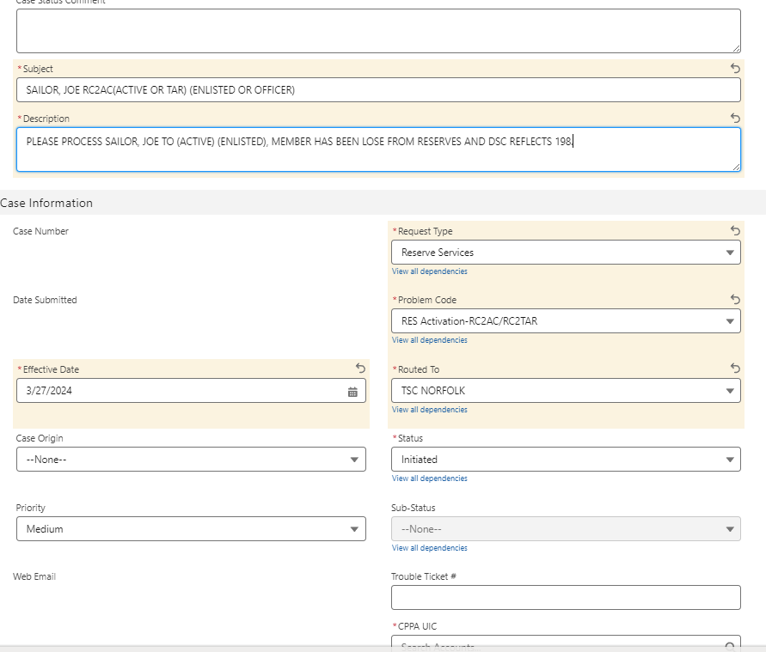
SAMPLE RC2AC/TAR eCRM (SALESFORCE) SUBMISSION
LAST, FIRST
LAST, FIRST

Slide 8
RC2AC/TAR KSDs - Enlisted
NAVPERS 1070/601: Manual Immediate Reenlistment contract
Conversion letter approval/CWAY letter
NAVPERS 1070/602: Official Dependency Data Form or Record of Emergency Data/Dependency Application (RED/DA)
  Dependency Application (revision 09-2016 or newer). Must be endorsed/witnessed (signed) official copy dated within 3 years of orders commencement date
DD Form 2058: State of Legal Residence
NPPSC 7000/1: Electronic Funds Transfer (EFT) Information
Naval Enlisted/Officer Participation System (NEOPS)/Annual Statement of Service History (ASOSH) (whichever is more up to date)
  https://www.mynavyhr.navy.mil/Career-Management/Reserve-Personnel-Mgmt/Points-FAQ/
    NEOPS – NSIPS
    ASOSH – BOL
DD214s (unaccounted on NEOPS/ASOSH)
W-4 form (current year)
Overseas Housing Allowance (if applicable)
  DD Form 2367, Individual Overseas Housing Allowance Report (certified by Housing Office and Certifying Official; all applicable blocks 11 and 12)
  A copy of the member’s lease/mortgage shall accompany

Slide 9
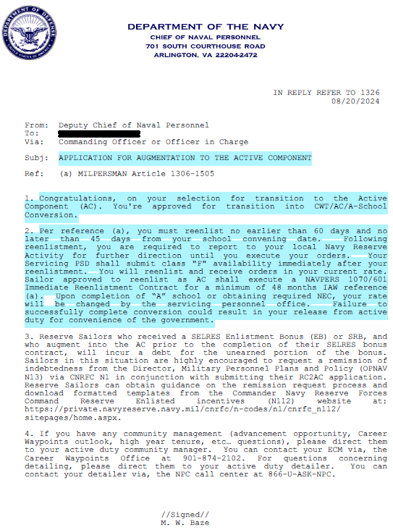
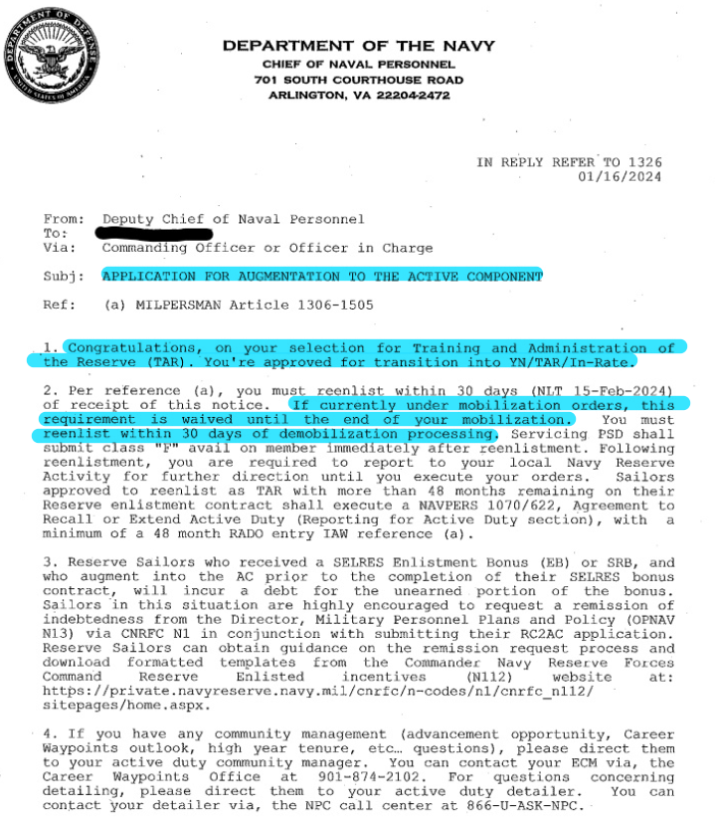
SAMPLE RC2AC/TAR CONVERSION LETTER APPROVAL

Slide 10
RC2AC/TAR KSDs - Officer
Officer Appointment letter (RC2TAR only)
NAVPERS 1000/4: Oath of Office (RC2AC only)
PCS Orders (endorsed)
NAVPERS 1070/602: Official Dependency Data Form or Record of Emergency Data/Dependency Application (RED/DA)
  Dependency Application (revision 09-2016 or newer). Must be endorsed/witnessed (signed) official copy dated within 3 years of orders commencement date
DD Form 2058: State of Legal Residence
NPPSC 7000/1: Electronic Funds Transfer (EFT) Information
Naval Enlisted/Officer Participation System (NEOPS)/Annual Statement of Service History (ASOSH) (whichever is more up to date)
  https://www.mynavyhr.navy.mil/Career-Management/Reserve-Personnel-Mgmt/Points-FAQ/
    NEOPS – NSIPS
    ASOSH – BOL
DD214s (unaccounted on NEOPS/ASOSH)
W-4 form (current year)
Overseas Housing Allowance (if applicable)
  DD Form 2367: Individual Overseas Housing Allowance Report (certified by Housing Office and Certifying Official; all applicable blocks 11 and 12).
  A copy of the member’s lease/mortgage shall accompany

Slide 11
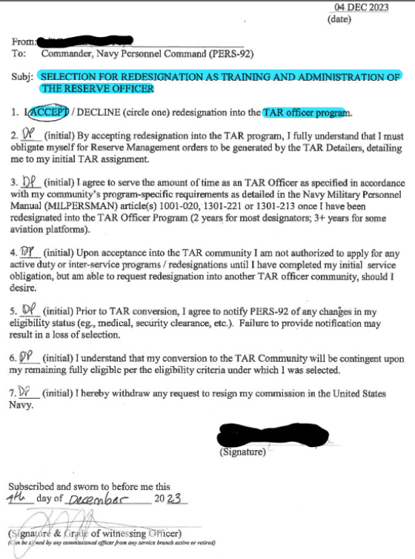
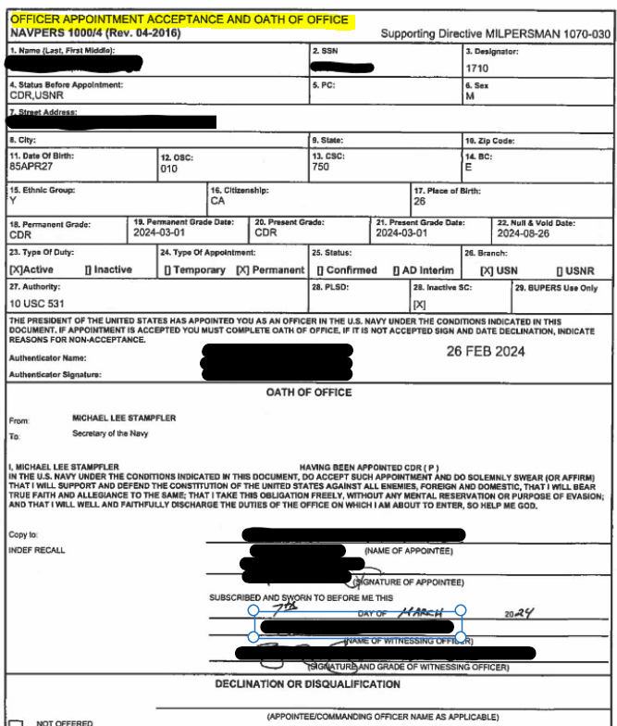
SAMPLE APPOINTMET LETTER AND OATH OF OFFICE
Officer Appointment Letter (RC2TAR only)
Oath of Office (RC2AC only)

Slide 12
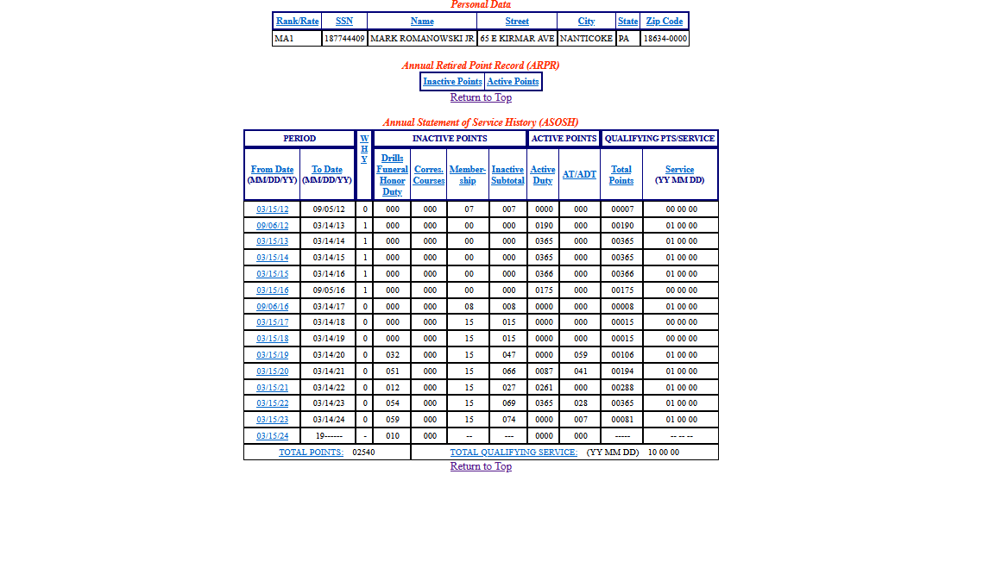
HOW TO CALCULATE Active Duty Service Date (ADSD)

Slide 13
HOW TO CALCULATE Active Duty Service Date (ADSD)
When calculating an ADSD, we use the members NEOPS/ASOSH to do so. We add all Active Points (Active Duty and AT/ADT) together and subtract it from the member’s Current Enlistment Date (CED) for Enlisted or DGAD (report date) for Officers.
For example, using the provided ASOSH screenshot, the total sum of all Active duty days and all AT/ADT days together equals to 2,309 days.
Using the formula below, convert the total sum into a date format (YY/MM/DD) to calculate the new ADSD.
Formula: 365 days in a year, 30 days in a month, and remainder will be the number of days
Using the example above: total sum = 2,309.
2309/365 = 6.33 days = 6 years); 6 x 365 = 2190 days
2309 - 2190 = 119 days; 119/30 = 3.97 = 3 months; 3 x 30 = 90
119 - 90 = 29 days *** Notice that we did not add an “inclusive day”? It’s because we are just converting the number to a date. ***
Now, using the 06 years 03 months, and 29 days, we can subtract from the member’s CED or DGAD. For example, see calculation below if CED is 3/27/2024.
24 03 27
- 06 03 29
17 11 29
*** Notice that we added an inclusive day? It’s to properly account for all creditable service. *** New ADSD = 11/29//2017

Slide 14
RC2AC/TAR WHILE ON ACTIVE DUTY ORDERS
MILPERSMAN 1306-1502
RC personnel in receipt of mobilization orders, on mobilization or active duty for operational support (ADOS) orders (formerly known as active duty for special work (ADSW), on extended active duty for training (ADT) orders, or on definite recall orders must be within 90 days of the end of these orders prior to applying for this program. RC personnel in receipt of mobilization orders, on mobilization orders, or on definite recall orders and submitting an RC2AC or RC2TAR application must complete the period of active service set forth in their current orders.
CANREC Program Sailors applying for a component change or recall to active duty as TAR must be within 90 days of completing their orders and have filed an intent not to seek an extension to CANREC orders (non-continuation intent) with NAVPERSCOM Affiliation and Redesignation Division (PERS-92). CANREC Program Sailors will be required to complete their obligated service under their current orders.

Slide 15
RC2AC/TAR WHILE ON ACTIVE DUTY ORDERS
ENLISTED
For SELRES converting to RC2AC/TAR while on Active Duty (AD) orders (ADOS, MOB, Recall), submit a Salesforce case (eCRM) to RCOE to include all required KSDs for RC2AC/TAR package. Ensure to specify that member was selected for RC2AC/TAR conversion in the description.
Upon receipt of PCS orders, request an Activity Loss, then Activity Gain to respective TSCs (either TSC Pensacola, TSC San Diego, or TSC Yokosuka).
  Do not submit to RCOE for processing
SELRES on AD has the option to complete their AD orders and convert to AC or TAR, 30 days after completing orders.
  Once SELRES are on AD, they are to physically muster with the current active duty command until new PCS orders have been cut to their Ultimate Duty Station.
    For example, Sailor is MOB in Virginia, but the family lives in New York, member will receive Virginia BAH although family remains in New York.
OFFICER
Upon receipt of PCS orders, request an Activity Loss, then Activity Gain to respective TSCs (either TSC Pensacola, TSC San Diego, or TSC Yokosuka).

Slide 16
RC2AC/TAR Common errors and issues
Strength loss not complete or completed incorrectly
  Improper DSC (member remained DSC 200 vice DSC 198)
  Improper date (member’s loss date was released for the wrong date)
Incomplete packages
  Missing KSDs
  Incorrectly completed KSDs
    Endorsements on orders (missing or not matching)
    Page 2 not signed or within periodicity
      Must be certified by the verifying official
    Incorrect NAVPERS 1070/601
      Incorrect UIC (use Active Duty UIC)
      Incorrect RADO (RC2TAR only)
        Must equal to # of months/days of reenlistment years: for example, 4 years = 048/000)
Packages submitted to incorrect queue in Salesforce (TSC Great Lakes vice TSC Norfolk)
Late submissions
Non-responsive CPPAs (CPPA Action)
Inaccurate NEOPS/ASOSH

Slide 17
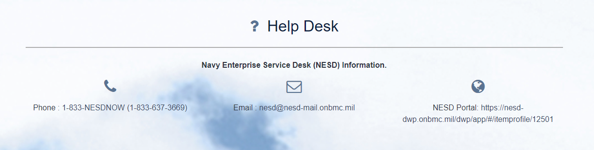
NESD Trouble Ticket information
NESD Trouble Ticket
In cases of incorrect DSC or incorrect loss date, cancel the transaction and re-do the loss in NSIPS.
In instances that cancellation does not fix the issue, NRAs should submit an NESD trouble ticket to request for resolution

Slide 18


